Slide 2
Development and Behavior

Slide 3
Endocrine System
Endocrine and Nervous systems – closely related
Hormones
1. Brain H. / Prothoracicotropic H. (PTTH)
- Made by Brain
- Stimulates the Prothoracic Grand (PG)
- Make ecdysone
  2. Ecdysone / Molting H.
  - Made by Prothoracic gland
  - Stimulate molting, egg production
  3. Juvenile H.
  - Made by Corpora Allata
  - High levels cause molt to produce another immature stage
  - Controls development of eggs in adults
  - Inhibits metamorphosis
Notes:
Insect Control
Pyrethrms – plant products used in sprays to kill adult insects
Hydroprene -

Slide 4
Reproductive Systems
3. Vagina
- Bursa copulatrix
4. Ovipositor +
- Spermatotheca = stores sperm
- Accessory glands = adhesives, foam to cover eggs
- Ovipositor = segments 8+9
5. Exceptions
- Parthenogenesis = dev. of egg wo fert.
- Paedogenesis = repro by pre-adult insect
- Polyembryony = development of more than one embryo from one egg

Slide 5
Reproductive Systems – Male
1. Testes – paired
2. Vas Efferens – connects follicle and vas deferens
3. Vas Deferens – single tube
4. Seminal Vesicles – sperm storage
5. Spermatophore = sperm packet

Slide 6
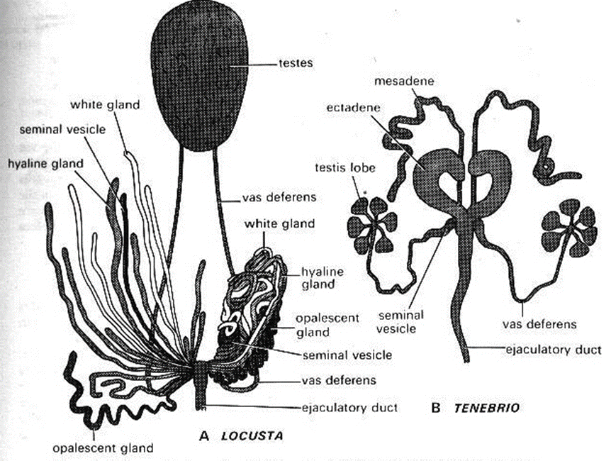
Notes:
TESTES, VAS EFEREBCES< to vas deferences, come down to the portion base, then seminal vesicle, and then moves out through ejaculatory duct.
Know the pathcway going out.

Slide 7
Reproductive Systems – Male cont.
5. Ejaculatory Duct – median tube
6. Accessory glands
- Spermatophore – capsule
7. External Genetalia
- Parameres – outer clasping organs
- Aedeagus (penis)

Slide 8
Development
  Sex chromosomes
    Typical for insects -- XX (female); XO (male). Grasshoppers.
    Fruit flies -- XX (female); XY (male)
    Butterflies -- XY (female); XX (male)
  In some hymenoptera, sex is determined by fertilization of eggs
    Males are haploid

Slide 9
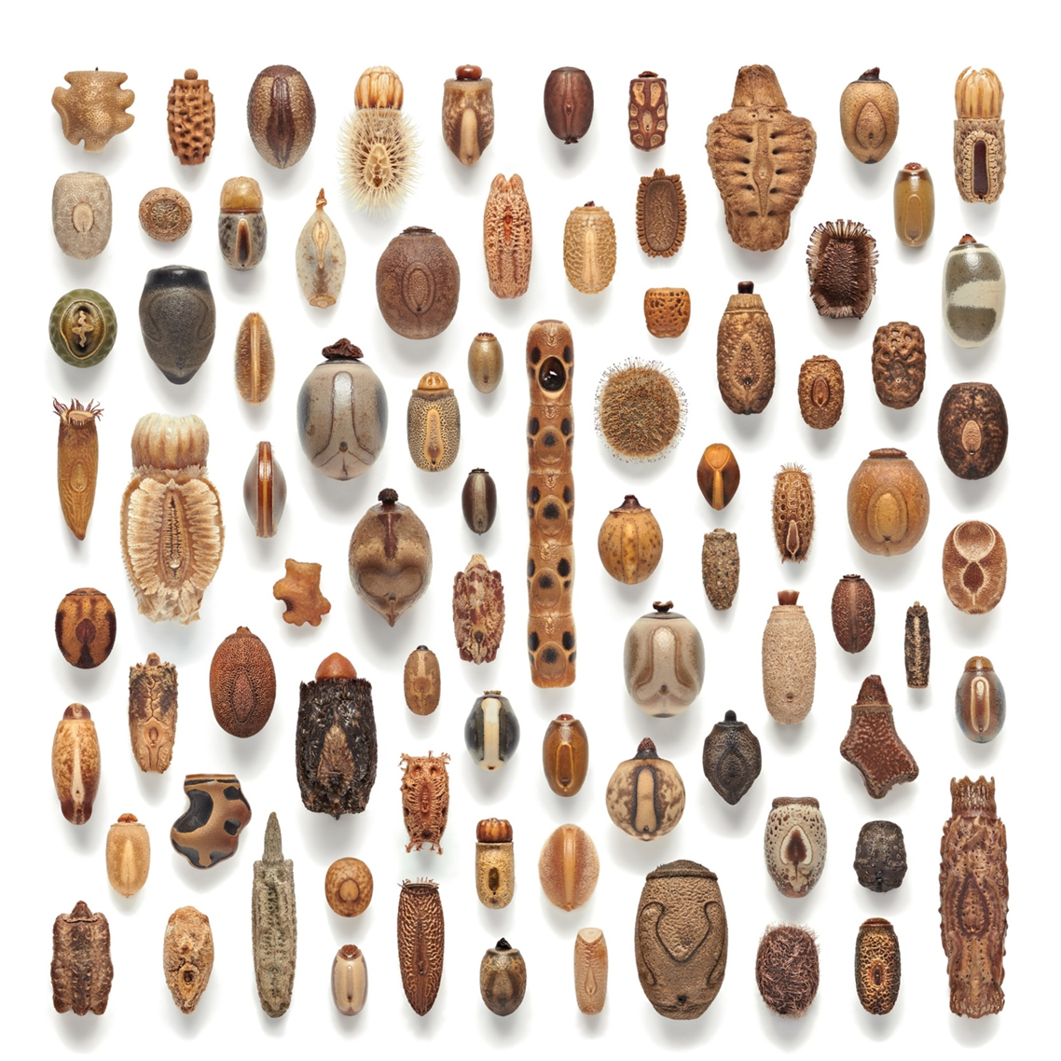

Slide 10
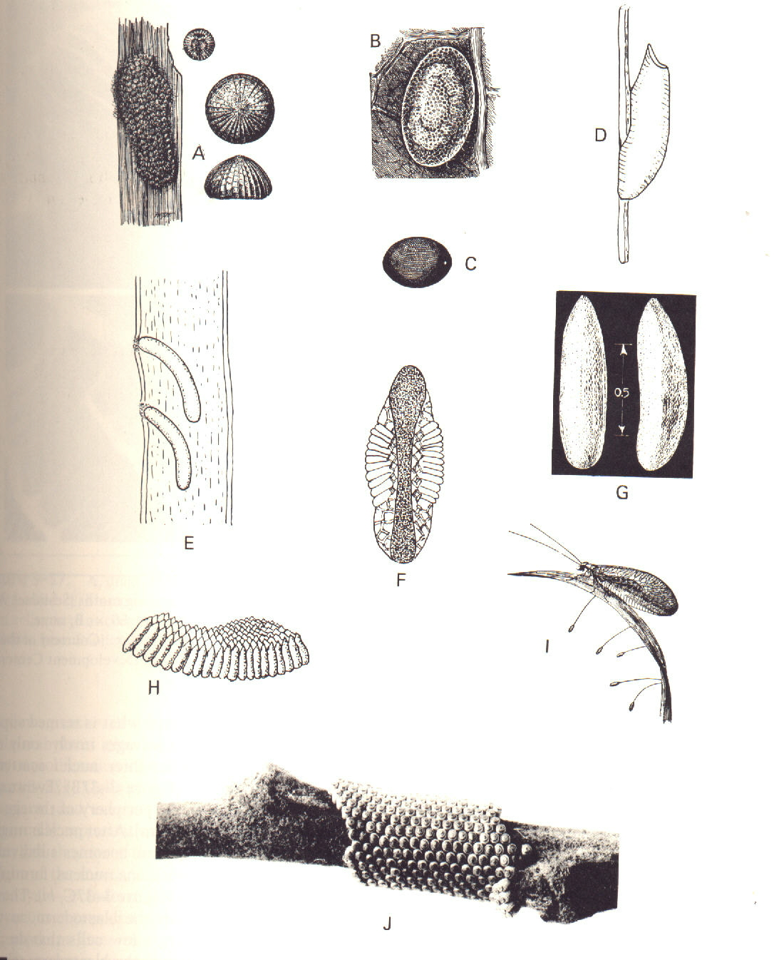
Eggs
  Most insects are oviparous
  Few are ovoviviparous

Slide 11
Post-embryonic Growth
1. Apolysis = separation of old cuticle from epidermis
2. Molting = Digest old and make new cuticle
- Ecdysis
3. Instar = stage between egg and molt

Slide 12
Eggs – cont.
1. Lay eggs on food source
2. Eclosion = hatching
3. Polyembryony = 2 to 1500 from one egg.
Notes:
Eclosion through growing up and bursting the egg. Made through the air and water coming in and they expand.

Slide 13
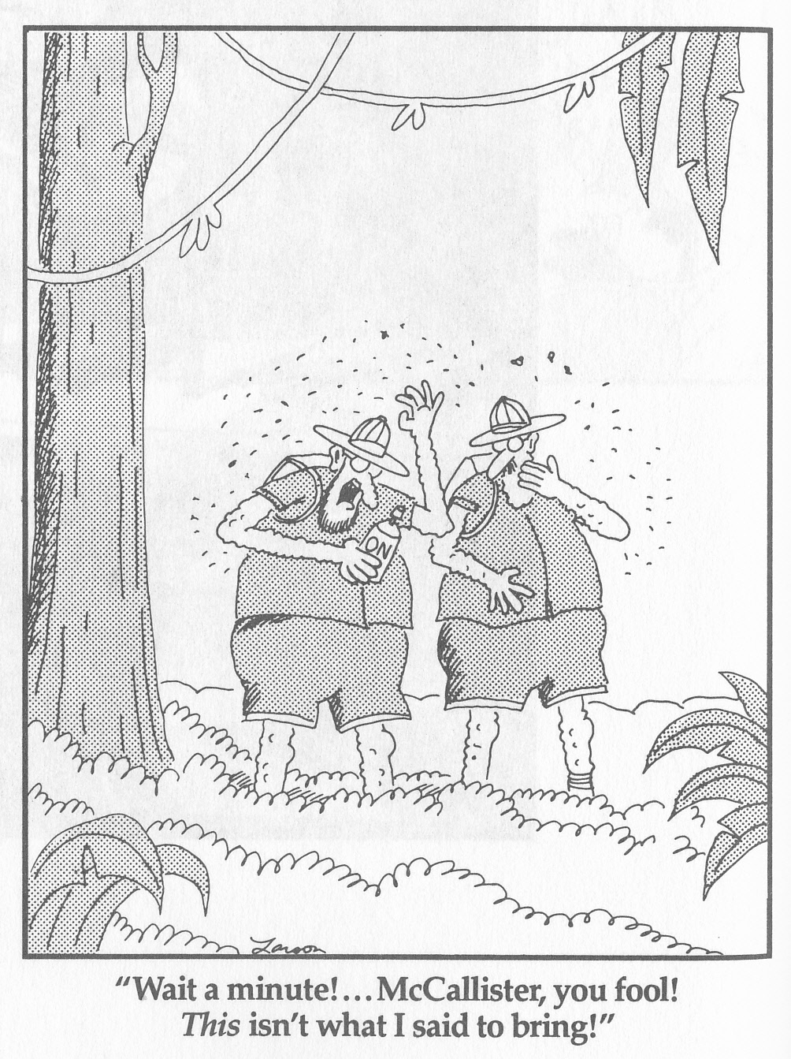

Slide 14
Molting Steps
  PTTH stim. prothoracic glands
  PG make ecdysone: stim. apolysis
  Epidermis makes new cuticle above it
  Molting fluid (from epidermis) digests endocuticle
Notes:
IMPORTANT

Slide 15
Life Histories
  Heterodynamic life cycle. Has a period of dormancy (diapause).
  Homodynamic life cycle. Continuous development.

Slide 16
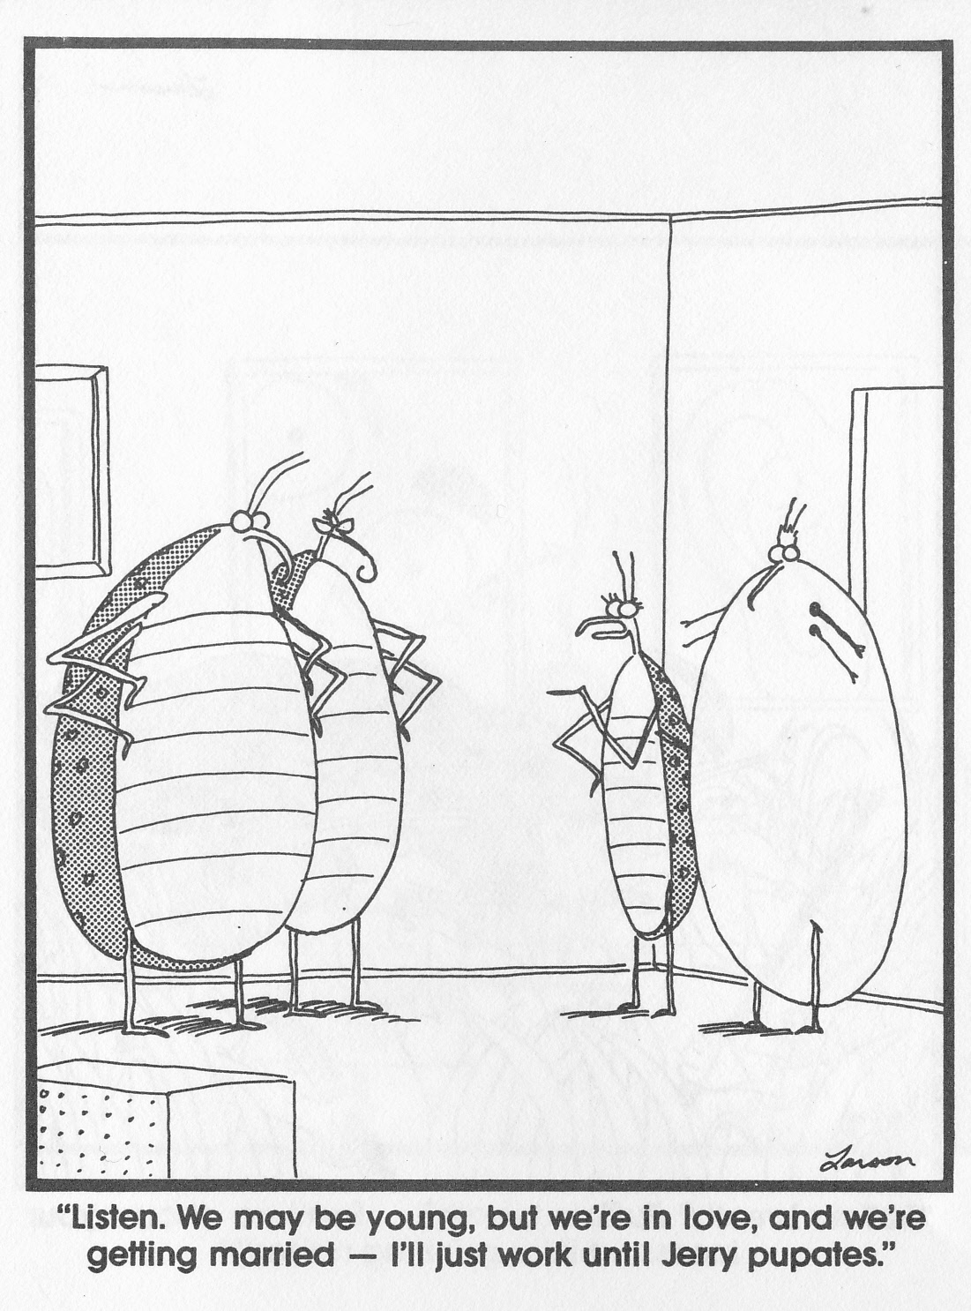

Slide 17
Larvae type:
Eruciform
  Caterpillar-like. Body cylindrical
  Head well developed
  Both thoracic legs and abdominal prolegs

Slide 18
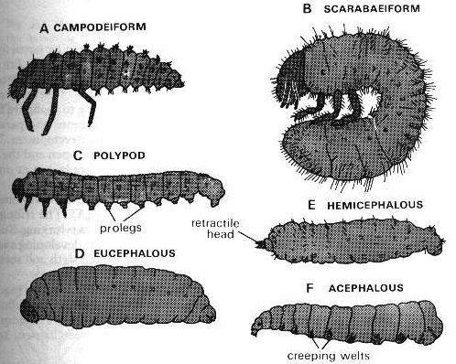
Larvae type:
Scarabaeiform Grub-like, curved
  Head well developed
  Thoracic legs. No abdominal prolegs

Slide 19
Larvae type:
Campodeiform
  Resembling diplurans
  Body elongate and somewhat flattened
  Thoracic legs well developed

Slide 20
Larvae type:
Elateriform: Wire-worm-like, body elongate, cylindrical and hard-shelled
  Legs short
Vermiform
  Maggot-like, body elongate and worm-like
  Legless
  With or without a well-developed head

Slide 21
Types of Pupae
Obtect
  Appendages +- glued to the body.
  Also known as a chrysalis.

Slide 22
Exarate
  Appendages free, not glued to body
Coarctate
  Like exarate but remains covered by the hardened cuticle of the last larval instar, the puparium

Slide 23
Metamorphosis – Simple
Incomplete
Ametabolous – No change
  Immature look like adults
Hemimetabolous – Incomplete metamorphosis
  Gill-breathing, very different than adults
Paurometabolous – Gradual metamorphosis
  Immature lack wings and genitalia
Notes:
Just memorize term and definition.
AMETABOLOUS – picked up stuff in jars. Colembula. Ametabolous. Diplourins, they don’t have wings anyway.
Hemimetabolous – mayflies, dragonflies Caddisflies, stoneflies.
Paurometabolous – Almost have prey to
COMPLETE METAMORPHASIS
Holo Metaomrphisiss – larvae, pupae, adult. Larvae has cewing mouth. As an adult it takes the sink to darken.
Alll dry wings, no regrowth in the wings.
Hypermetamorphaisis – where we get the dipteras, the hyper . They have larvae inside change.
TEST UP TO THIS POINT

Slide 24
Genesis 1:24
And God said, "Let the land produce living creatures according to their kinds: livestock,
creatures that move along the ground, and wild animals, each according to its kind." And it was so.

